Slide 1


Titolo presentazione sottotitolo
Non-Linear Distortion
Milano, XX mese 20XX
Sound Analysis, Synthesis and Processing
Juan Camilo Albarracín
Alberto Doimo
Riccardo Iaccarino

Slide 2
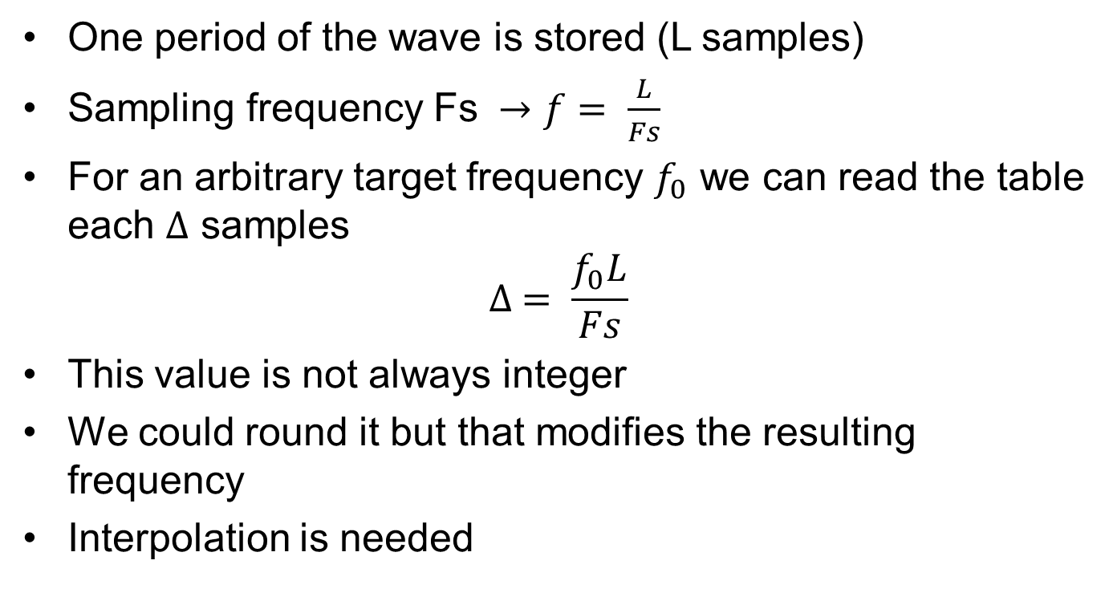
Wavetable Synthesis
One period of the wave is stored (L samples)
Sampling frequency Fs $→f= \frac{L}{Fs}$
For an arbitrary target frequency $f_{0}$ we can read the table each $∆$ samples
$$∆ = \frac{f_{0}L}{Fs}$$
This value is not always integer
We could round it but that modifies the resulting frequency
Interpolation is needed

Slide 3
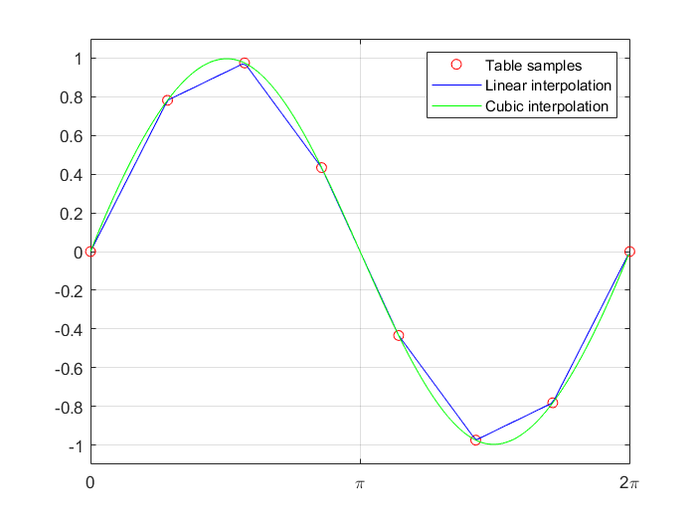
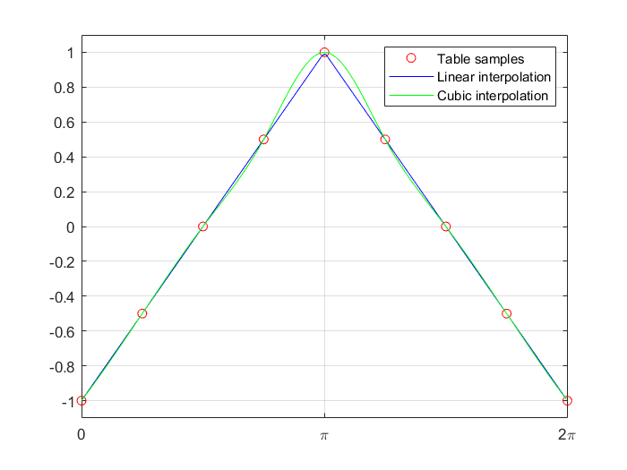
Interpolation
Find values of the wave between the precomputed ones
We compare the efficiency of linear and cubic interpolation in different configurations
Higher order does not necessairly mean increased accuracy

Slide 4
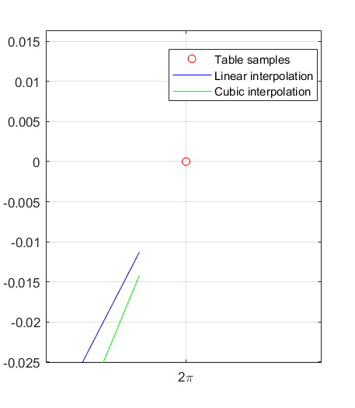
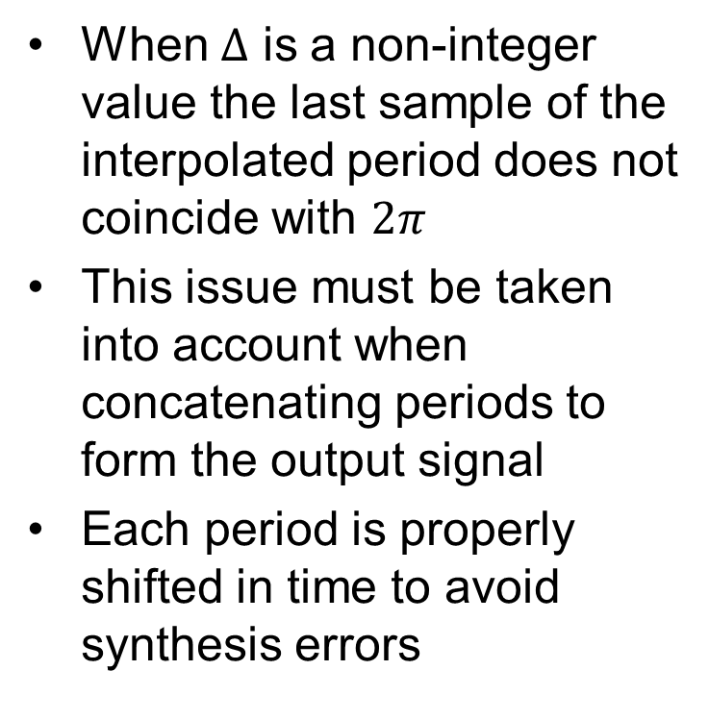
Wrap
When $∆$ is a non-integer value the last sample of the interpolated period does not coincide with $2π$
This issue must be taken into account when concatenating periods to form the output signal
Each period is properly shifted in time to avoid synthesis errors

Slide 5
Distortion
Distortion can be described by a characteristic curve, a mathematical function relating the output sample y[n] to the input sample x[n].
If the distortion function applies to the codomain only so it changes values along y axis, it’s called WAVESHAPING
If the distortion function instead applies to the domain only so it moves values along x axis, it’s called PHASE DISTORTION

Slide 6
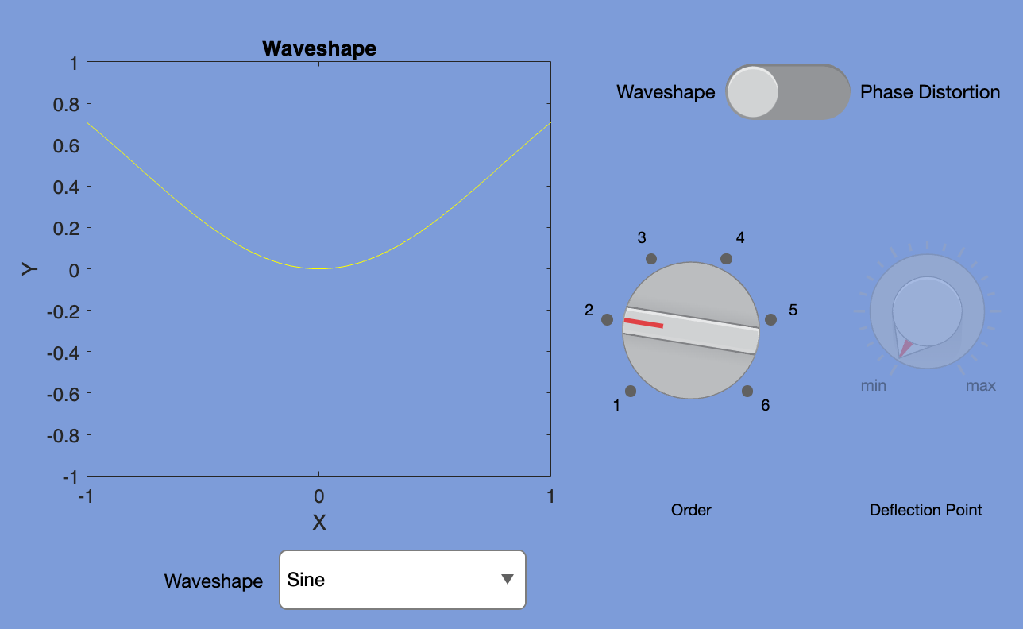
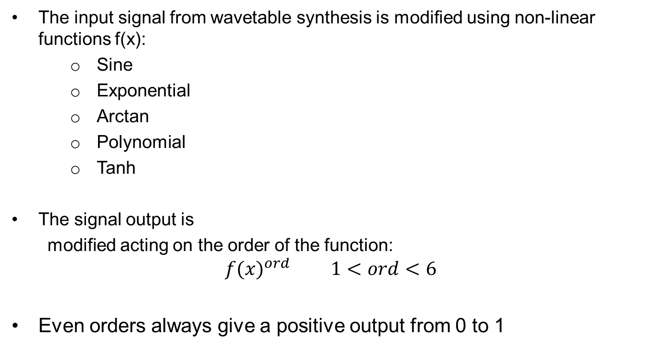
Waveshaping
The input signal from wavetable synthesis is modified using non-linear functions f(x):
Sine
Exponential
Arctan
Polynomial
Tanh
The signal output is
modified acting on the order of the function:
$${f(x)}^{ord} 1<ord<6$$
Even orders always give a positive output from 0 to 1

Slide 7
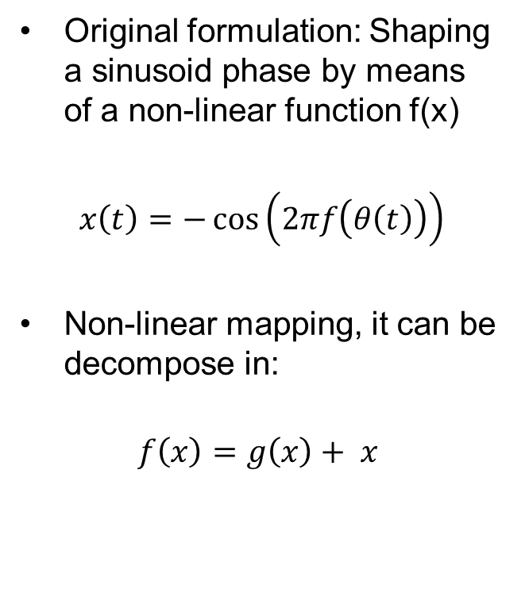
Phase distortion
Original formulation: Shaping a sinusoid phase by means of a non-linear function f(x)
$x\left(t\right)=−\cos\left(2πf\left(θ\left(t\right)\right)\right)$
Non-linear mapping, it can be decompose in:
$$f\left(x\right)=g\left(x\right)+ x$$

Slide 8
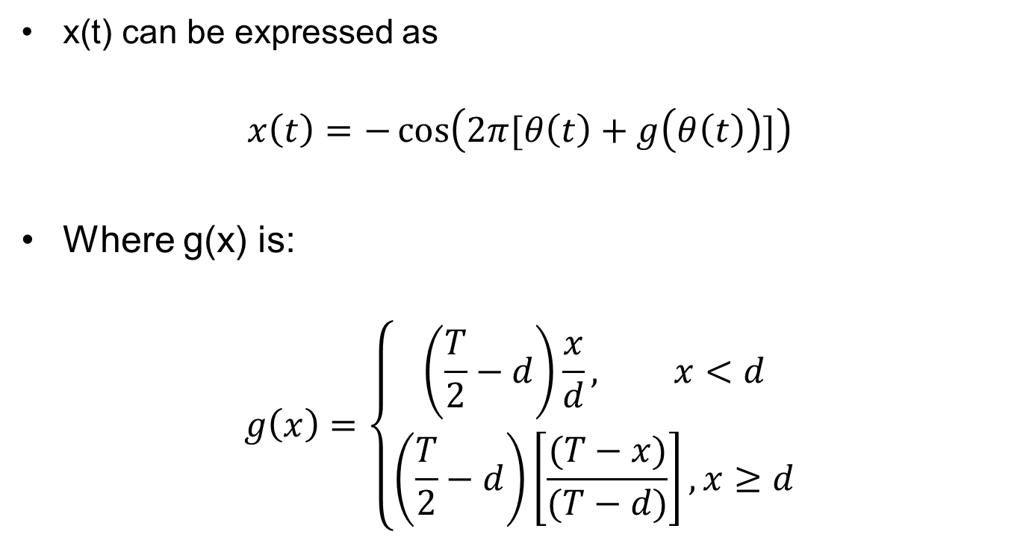
Phase distortion
x(t) can be expressed as
$$x\left(t\right)=−\cos\left(2π[θ\left(t\right)+g\left(θ\left(t\right)\right)]\right)$$
Where g(x) is:
$$g\left(x\right)=\left\{\begin{aligned}\left(\frac{T}{2}−d\right)\frac{x}{d}, x<d \\ \left(\frac{T}{2}−d\right)\left[\frac{(T−x)}{(T−d)}\right], x≥d\end{aligned}\right.$$

Slide 9
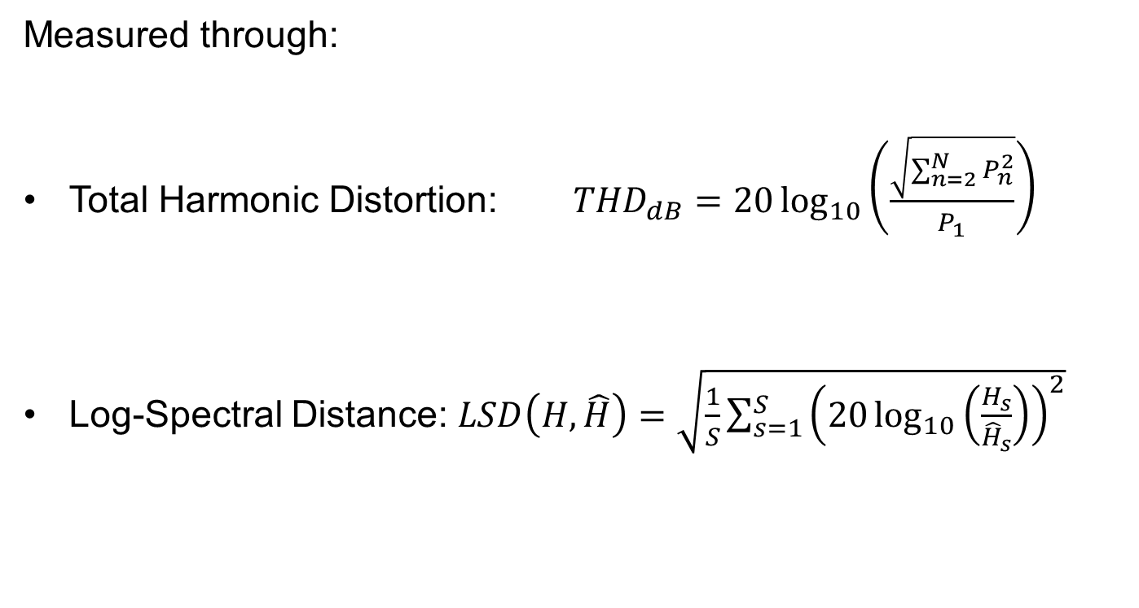
Spectrum impact
Measured through:
Total Harmonic Distortion: ${THD}_{dB}=20\log_{10}\left(\frac{\sqrt{\sum_{n=2}^{N}{P_{n}^{2}}}}{P_{1}}\right)$
Log-Spectral Distance: $LSD\left(H,\hat{H}\right)=\sqrt{\frac{1}{S}\sum_{s=1}^{S}{{\left(20\log_{10}\left(\frac{H_{s}}{{\hat{H}}_{s}}\right)\right)}^{2}}}$

Slide 10
Further developments
More complex waveshaping functions
Additional interpolation methods
Drawable wavetable.

Slide 11
References
https://en.wikibooks.org/wiki/Sound_Synthesis_Theory/Oscillators_and_Wavetables
Lazzarini, Victor & Timoney, Joe & Pekonen, Jussi & Välimäki, Vesa & Pekonen@tkk, Jussi & Fi, Vesa & Fi,. (2009). Adaptive Phase Distortion synthesis.
Reiss, J., &#38; McPherson, A. (2014). Audio Effects (1st ed.). CRC Press. Retrieved from https://www.perlego.com/book/1604499/audio-effects-theory-implementation-and-application-pdf (Original work published 2014)

Slide 12
Thanks for the attention

